Slide 1
Notes:
This red line represents God

Slide 2
Notes:
The green line is the Earth with vegetation

Slide 3
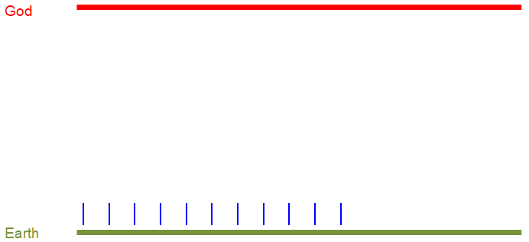
Notes:
These are animals

Slide 4
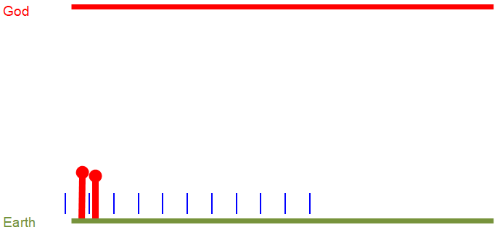
Notes:
This is Adam and Eve

Slide 5
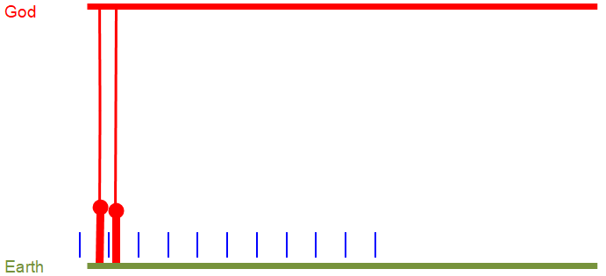
Notes:
Adam and Eve had a direct relationship with God

Slide 6
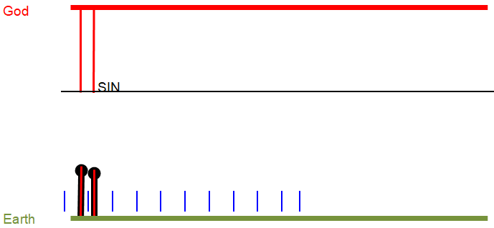
Notes:
But they sinned, and sin always blocks our relationship with God.

Slide 7
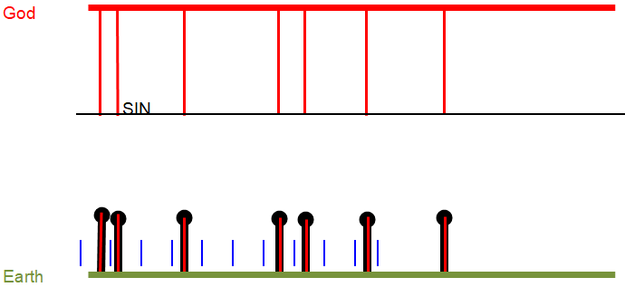
Notes:
Now people are born sinful but with an inbuilt spirituality.

Slide 8
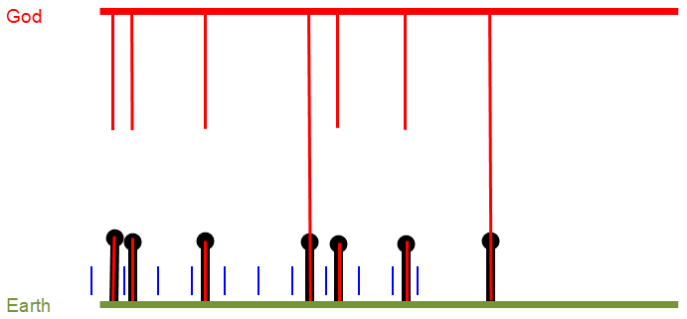
Notes:
Jesus took the punishment for sin and removed the barrier it had caused.

Slide 9
